Slide 1

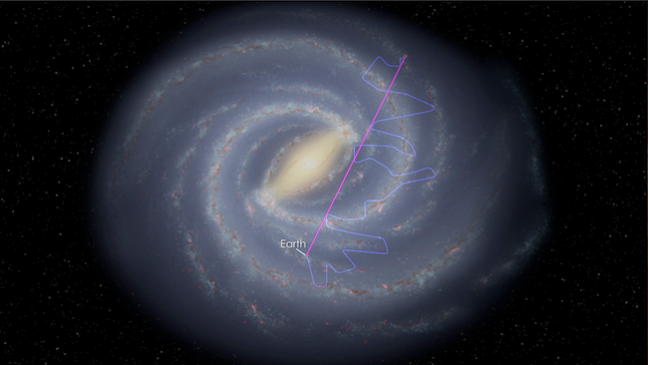
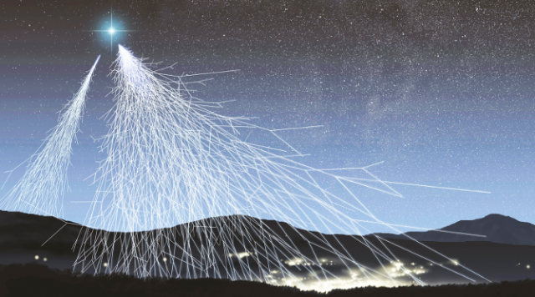
Notes:
Preload websites
bit.ly/HiSPARC_ch (blank spreadsheet)
data.hisparc.nl
And also the completed sheet at xbyrne.github.io/hisparc/heresoneimadeearlier.xlsx

Slide 2
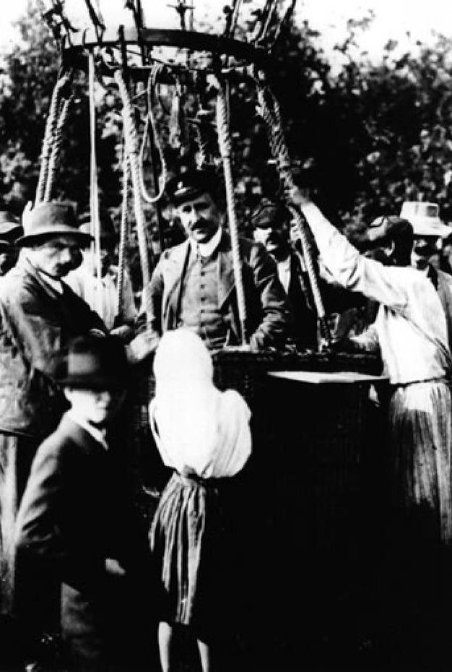
What are Cosmic Rays?
Particles moving at >0.99c
Energy 40,000,000 x LHC
Notes:
Hess was interested in the ionization of air.
Electroscope measurements showed decrease with altitude (inc up to Eiffel!) though not by as much as expected
Hess did some balloon trips up to ~5km; showed that eventually increased again
Got Nobel 1936

Slide 3
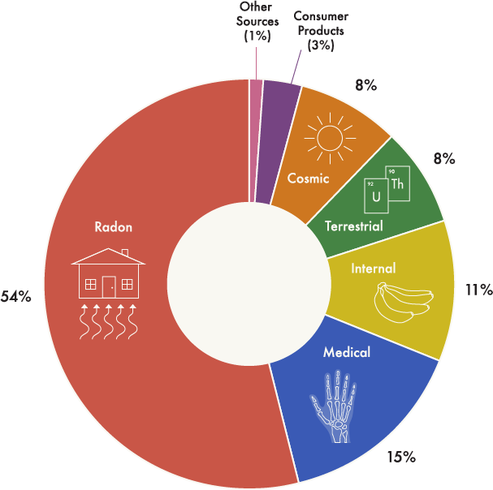
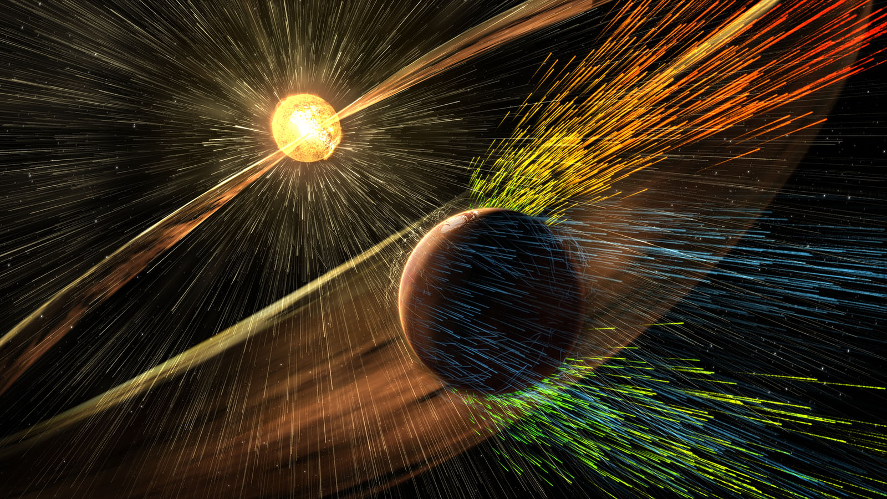
Background radiation
Carbon dating
Solar Wind
Examples
Notes:
Background radiation (1/6 from CRs) a major barrier to interplanetary travel
Cosmic rays convert atmospheric N into C-14.
Quebec blackout 1989
1 error/week/GB – inc 2013 Super Mario 64 speedrun

Slide 4
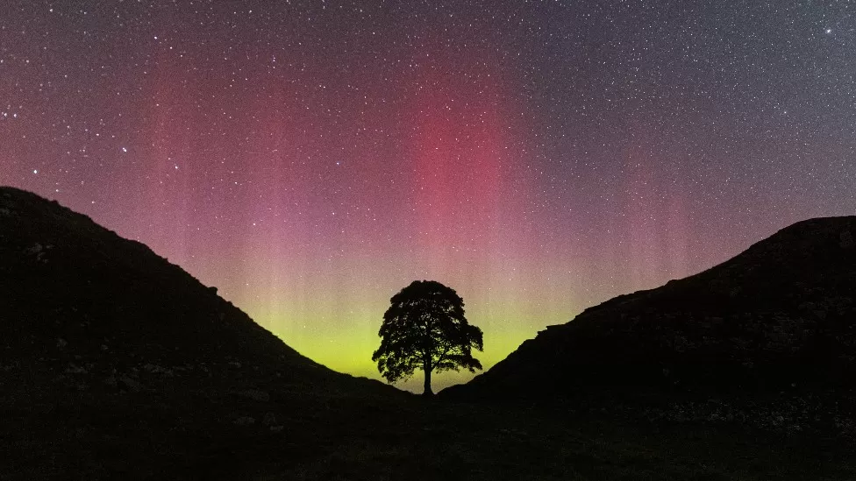
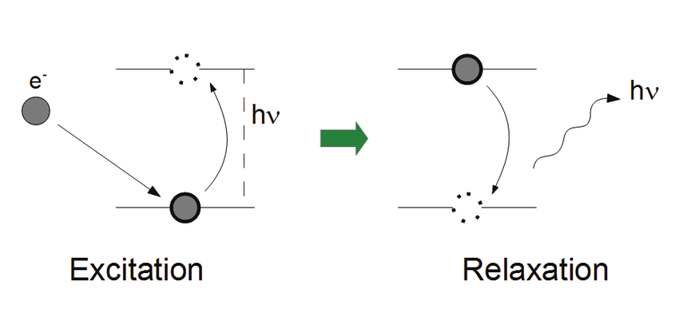
CR
e⁻
Credit: Wil Cheung
Notes:
Hexham on Tues eve

Slide 5
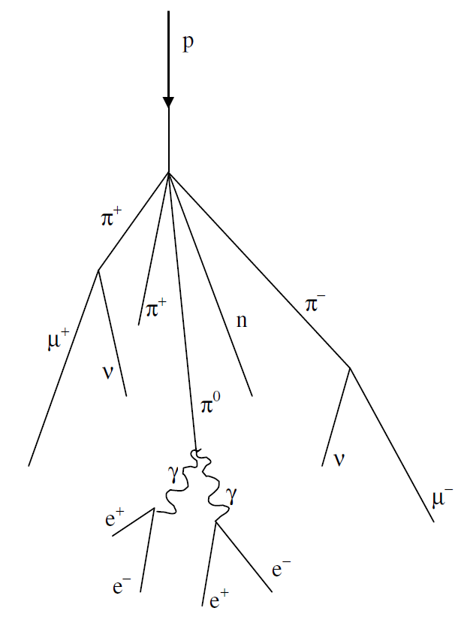
Collision also produces pions
Pions decay into muons (μ⁻) etc.
The muons are how HiSPARC detectors record cosmic rays
Muon Creation

Slide 6
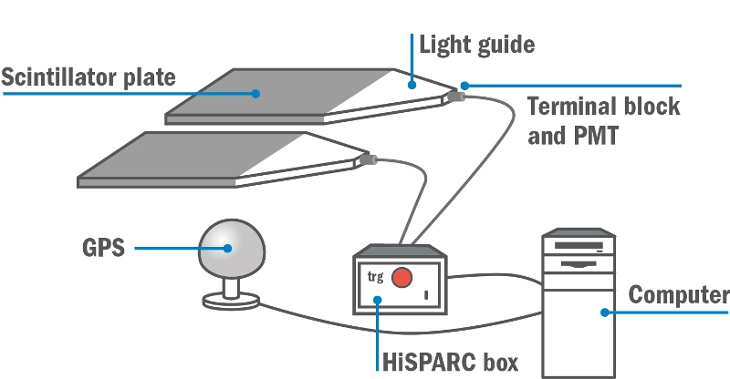
μ
e⁻
PMT: photomultiplier tube: photon to electrical signal
HiSPARC box records time (~ns); GPS records location
Muon Detection
Notes:
Some stations have extra data:
Temperature, pressure, weather, lightning…

Slide 7
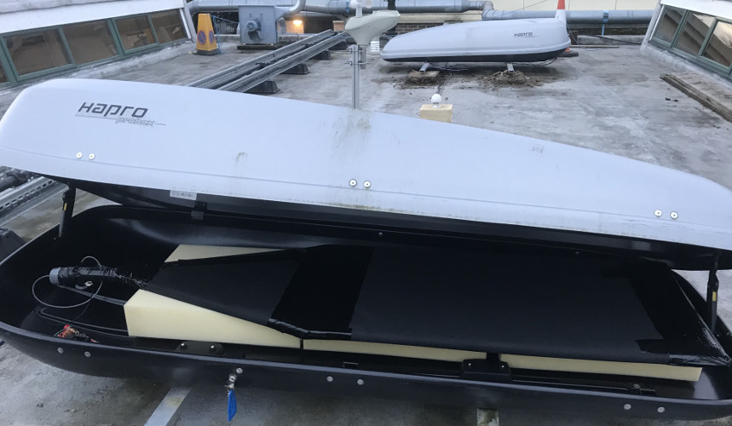
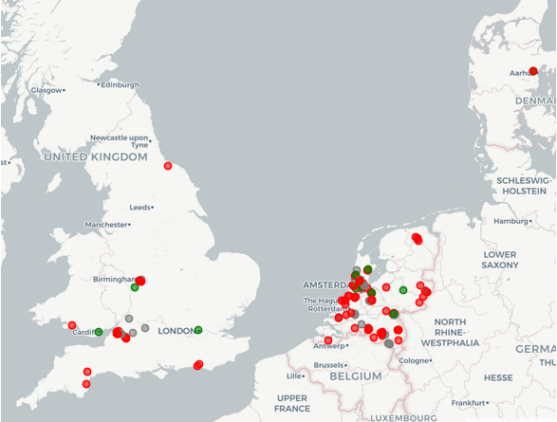
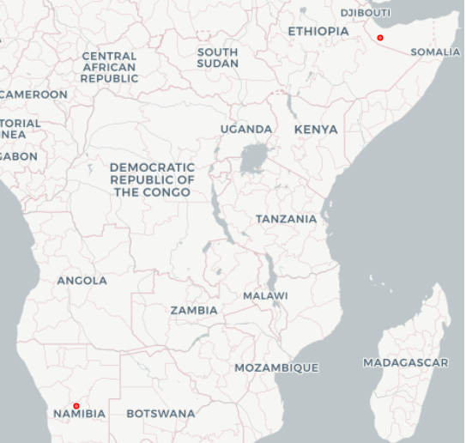


Notes:
University of Namibia, Windhoek,
University of Hargeisa, Rep. of Somaliland

Slide 8
HiSPARC Data – Summer-Winter Variation?
Summer-winter data at: bit.ly/HiSPARC_ch
File > Download > Microsoft Excel (.xlsx)
Fetch missing data from: data.hisparc.nl
From 13001: Bristol University
Find the sum of each day.

Slide 9
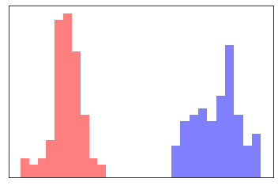
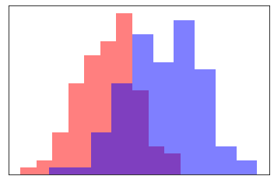

And the conclusion?
Summer
Winter
Need to compare difference in means $Δμ$ to overall variation $σ$

Slide 10

And the conclusion?
How different can the means be before we conclude that there is a significant variation?
We conclude that they are significantly different if $Δμ>5σ$
Otherwise, there is not enough evidence to suggest this wasn’t just a coincidence

Slide 11
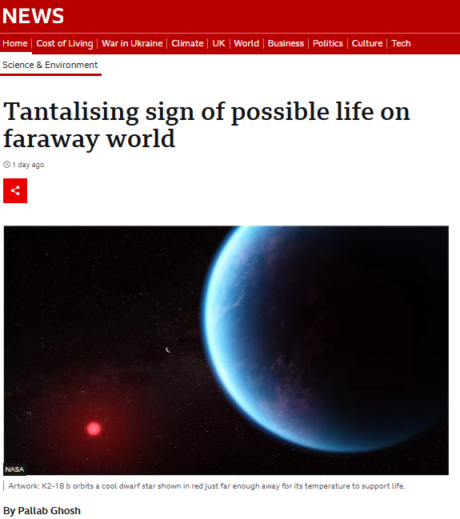
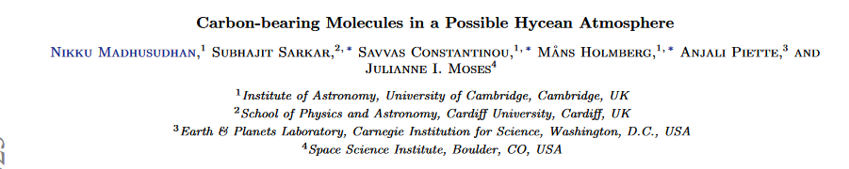
And the conclusion?
How different can the means be before we conclude that there is a significant variation?
We conclude that they are significantly different if $Δμ>5σ$
Otherwise, there is not enough evidence to suggest this wasn’t just a coincidence

Slide 12

And the conclusion?
Find the average (μ) and standard deviation (σ) of each week
Use the formulas AVERAGE() and STDEV.P()
Calculate the difference in means and overall standard deviation
$σ=\sqrt{σ_{s}^{2}+σ_{w}^{2}}$
Conclude whether there is a significant seasonal variation in the number of cosmic rays received

Slide 13
What next?
Think of a project to investigate using HiSPARC data
Previous research has included:
Day/Night, Latitude, Longitude, Altitude
Effects of humidity, temperature, lightning
Effects of eclipses and the Moon, solar cycle…
xbyrne.github.io/hisparc/links.html for more
Be creative! Can work in groups or solo
HiSPARC conference in the summer…?

Slide 14
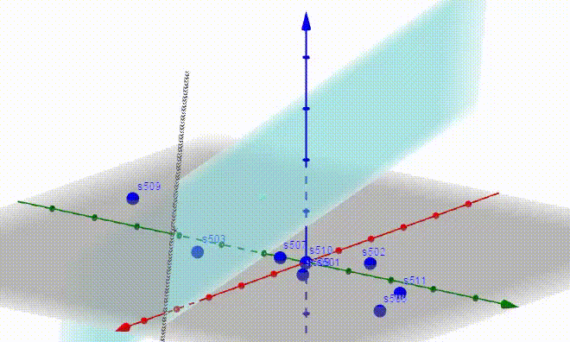
muons
detectors

